Slide 1
Banking Credit System
zzzz
zzzzzzz

Slide 2
Contents
1
Introduction
2
Development process
3
Demo
4
Q&A

Slide 3
Project management
Quality Assurance
Result
Introduction
Role
Group
Project
Role | Tasks in charge
Project manager Nguyen Thanh Long | Work out the plan and time table Team contact point General manage project Design, code, review, create reports
Developer, designer Phan Le Quang Chinh | Support technique Design, code, review, create reports In charge of building Mining module
Developer, designer Dao Mai Ly | Support technique Design, code, review, create reports In charge of building Ranking module
Developer, tester and QA Tran Thi Huong Giang | Design, code, review, create reports In charge of Testing and QA tasks Create test case, test data, operate IT
Developer, tester and QA Pham Thi Phuong Thao | Code, review, create reports In charge of Testing and QA tasks Create test case, operate IT Manage meeting minutes
Business context
Plan
Development process
Requirement
Design
Implement
Testing
Demo
Q&A

Slide 4
Project management
Quality Assurance
Result
Introduction
Time table
Group
Project
Project management
Business context
Quality Assurance
Review
Plan
Require-
ment
Design
Imple-
ment
Deploy-
ment
Development process
2010
2011
Requirement
Design
December
January
February
March
April
Implement
Testing
Demo
Q&A

Slide 5
Project management
Quality Assurance
Result
Introduction
Working process
Group
Plan
Code
Review
Log bugs
Project
Business context
Plan
Development process
Requirement
Design
Implement
Testing
Demo
Q&A

Slide 6
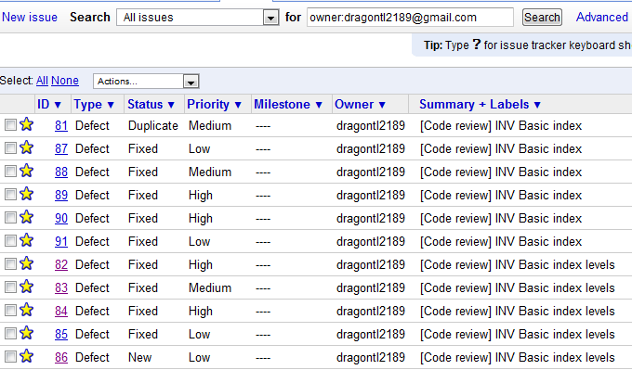
Project management
Quality Assurance
Result
Introduction
Working process – Bug management
Group
Project
Business context
Plan
Development process
Requirement
Design
Implement
Testing
Demo
Q&A

Slide 7
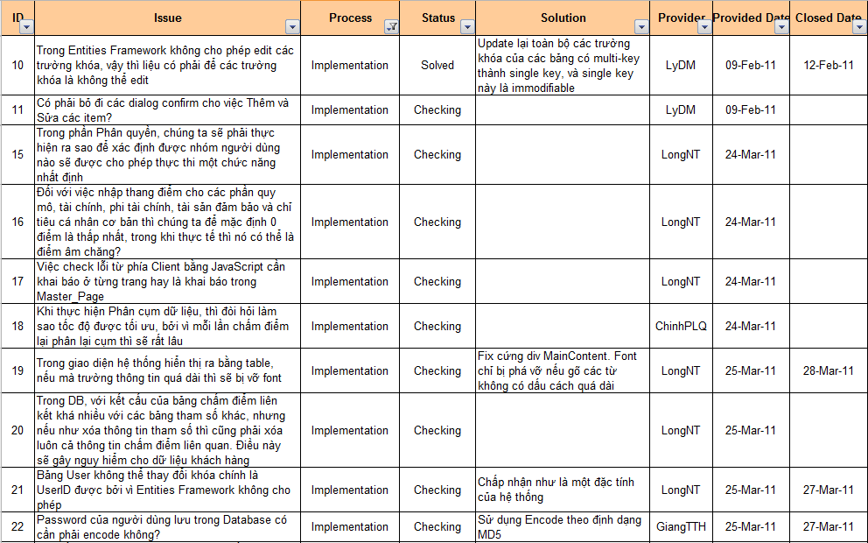
Project management
Quality Assurance
Result
Introduction
Working process – Issue management
Group
Project
Business context
Plan
Development process
Requirement
Design
Implement
Testing
Demo
Q&A

Slide 8
Project management
Quality Assurance
Result
Introduction
Implemented modules
Group
Project
Business context
Administration
Plan
Parameters
Development process
Ranking
Requirement
Design
Implement
Data Mining
Testing
Demo
Report
Q&A

Slide 9
Project management
Quality Assurance
Result
Introduction
Testing process
Group
Project
Create TC template
Write TC (based on SRS)
Review TC
Create test data
IT
Business context
Plan
Development process
Requirement
Design
Implement
Testing
Demo
Q&A

Slide 10
Project management
Quality Assurance
Result
Introduction
Testing process
Group
Project
Test case
Test data
Integration test
Business context
Plan
Development process
Requirement
Design
Implement
Testing
Demo
Q&A

Slide 11
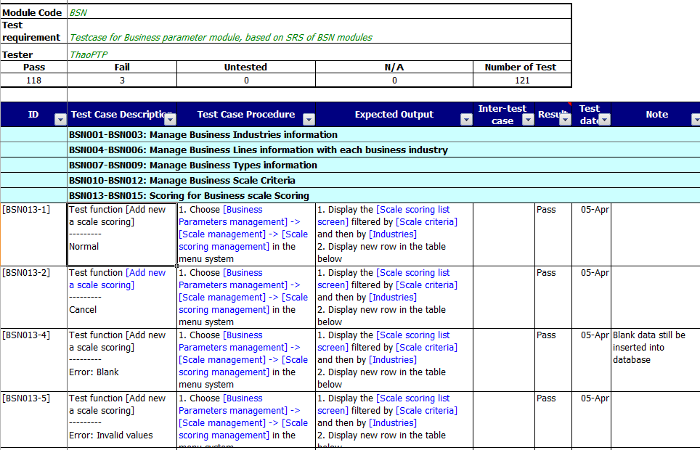
Project management
Quality Assurance
Result
Introduction
Test case
Group
Project
Business context
Plan
Development process
Requirement
Design
Implement
Testing
Demo
Q&A

Slide 12
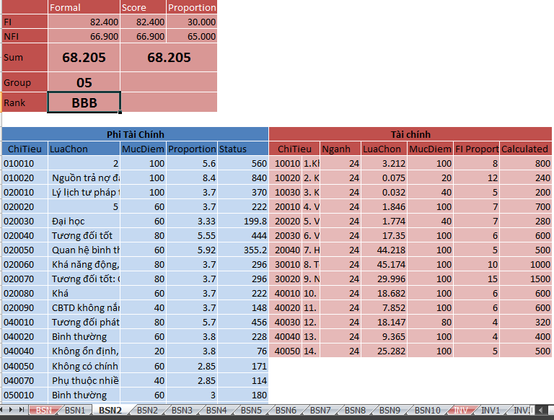
Project management
Quality Assurance
Result
Introduction
Test data
Group
Project
Business context
Plan
Development process
Requirement
Design
Implement
Testing
Demo
Q&A

Slide 13
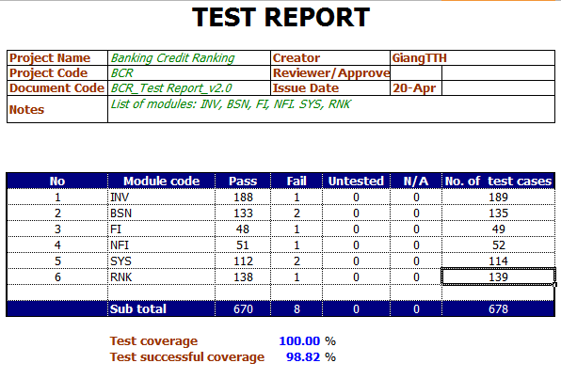
Project management
Quality Assurance
Result
Introduction
Test report
Group
Project
Business context
Plan
Development process
Requirement
Design
Implement
Testing
Demo
Q&A

Slide 14
Q&A

Slide 15
Thanks for listening!

